Slide 1
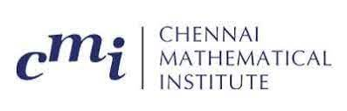
Case Study: How Netflix Works
Ankush Dey Ritirupa Dey Anjali Pugalia Shyam Krishna P
23rd April 2022
Instructor: prof Venkatesh Vinayakarao

Slide 2
Contents:
Introduction
What is Netflix
How they Evolve
Importance of AWS for Netflix
Databases that Netflix Use
Content Delivery Network - Open Connect
Microservices
Apache Spark
Security

Slide 3
Introduction :
Not long-ago Money Heist came back for its final season, finally ending a long wait for binge watchers across the world who are interested in an Spanish drama. For them, kicking off a marathon is as simple as reaching out for your device or remote, opening the Netflix app and hitting Play. Simple, fast and instantly gratifying.
It means building top-notch infrastructure at a scale no other Internet service has done before, it also means that a lot of participants in the experience have to be negotiated with and kept satiated
This is in most layman terms– How Netflix works.

Slide 4
What is Netflix:
Netflix is a subscription-based streaming service that allows us to watch TV shows and movies without commercials on an internet-connected device.
You can watch Netflix through any internet-connected device that offers the Netflix app, including smart TVs, game consoles, streaming media players, set-top boxes, smartphones, and tablets.
How they Evolve:
It all began in April 1998, when Netflix started renting out DVDs by mail. Only a year later Netflix changed its pay-for-use model into a subscription model.
Nearly a decade later, Netflix changed their proposition to a streaming service, which changed the way millions of people spend their free time.

Slide 5
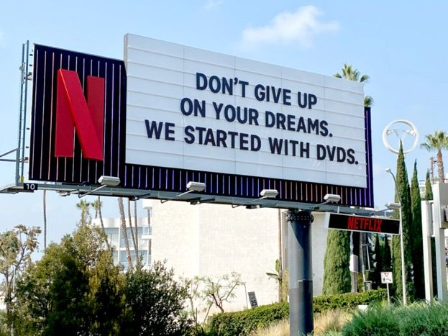
The key trends that are driving the exponential growth and are implemented in the current business model of Netflix are:
Technology
Comfort
On demand
;.
Data driven

Slide 6
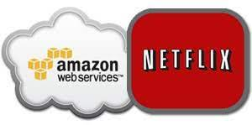
Importance of AWS for Netflix:
“The world may never had Netflix without AWS”
The AWS Cloud not only offered the greatest ability to scale – something which was critical for a business growing at their pace – but also the greatest portfolio of services.
Netflix user base has grown about 14 times since 2008 and data volume rise in the same period is second to none.
Netflix is way ahead than Youtube and Facebook in terms of data consumption as 15% of total Internet bandwidth available is being used by Netflix, while the number gets bigger in America.

Slide 7
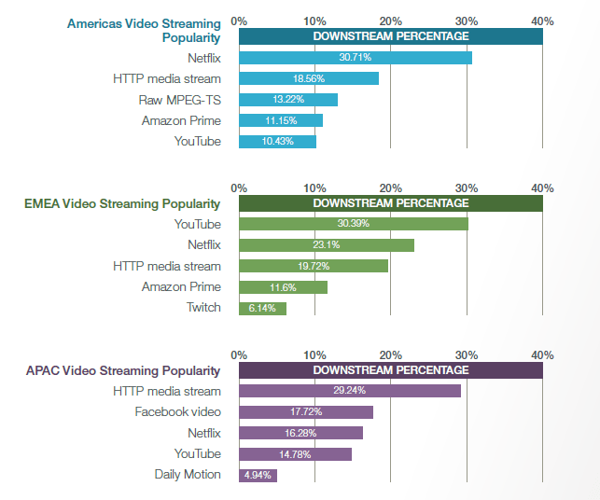

Slide 8
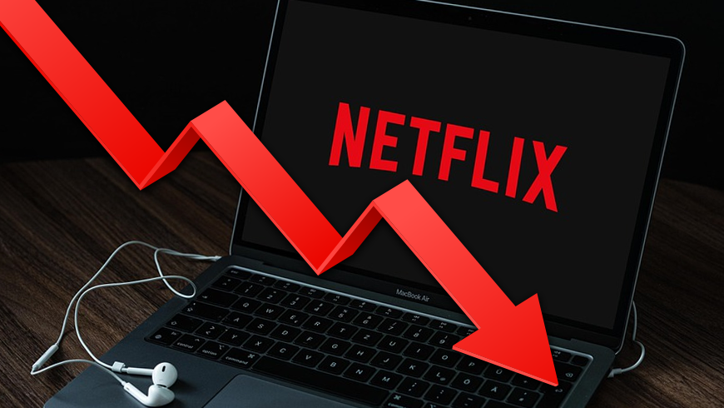
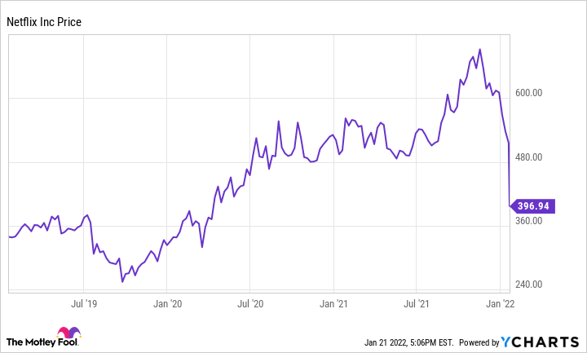
35% loss in 1 day!!

Slide 9
Databases That Netflix Use:
Netflix mainly uses three NoSQL tools: SimpleDB, HBase and Cassandra.
Netflix Director of Cloud and Systems Infrastructure Yury Izrailevsky explains how and why Netflix migrated some of its systems to NoSQL. He writes that the learning curve has been steep and re-architecting the company’s systems has been difficult
but the scalability, availability and performance advantages of the NoSQL persistence model are evident and are paying for themselves already, and will be central to our long-term cloud strategy.”

Slide 10
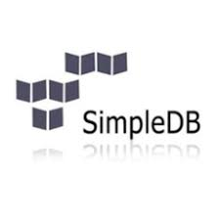
SimpleDB:
Amazon SimpleDB was a natural choice for a number of their use cases as they moved into AWS cloud.
SimpleDB is highly durable, with writes automatically replicated across availability zones within a region.
It also features some really handy query and data format features beyond a simple key/value interface, such as multiple attributes per row key, batch operations, consistent reads, etc

Slide 11
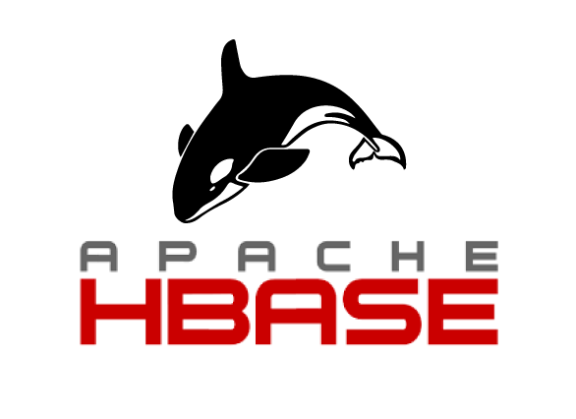
HBase:
Netflix uses HBase because it’s deeply integrated with Hadoop.
the biggest advantage in using HBase is the ability to combine real-time HBase queries with batch map-reduce Hadoop jobs, using HDFS as a shared storage platform.
however, that with HBase the company does have to sacrifice some availability for consistency.

Slide 12

Cassandra:
Netflix uses Cassandra for its scalability and lack of single points of failure and for cross-regional deployments.
Unlike a distributed database solution using e.g. MySQL or even SimpleDB, Cassandra (like HBase) can scale horizontally and dynamically by adding more servers, without the need to re-shard – or reboot, for that matter.
In fact, Cassandra seeks to avoid vertical scalability limits and bottlenecks of any sort: there are no dedicated name nodes (all cluster nodes can serve as such), no practical architectural limitations on data sizes, row/column counts, etc.

Slide 13
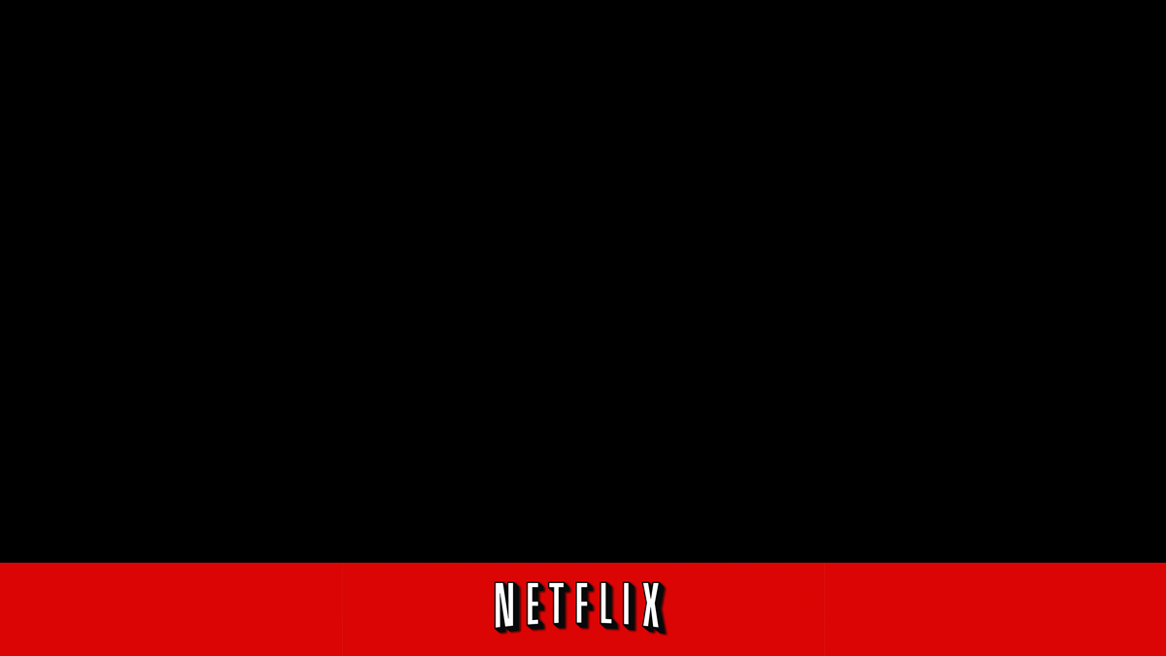
NETFLIX CONTENT DELIVERY NETWORK –
OPEN CONNECT

Slide 14


HOW AND WHY DID OPEN CONNECT EVOLVE?
Developed in 2011.
Proved to be a significant share of internet traffic in every market in which they operated.
Wanted to use their knowledge to build a more efficient CDN.
Sophisticated popularity models ensure that the right file is on the right server at the right time.
Pre-positioning content in this way allows to avoid any significant utilization of internet “backbone” capacity.

Slide 15
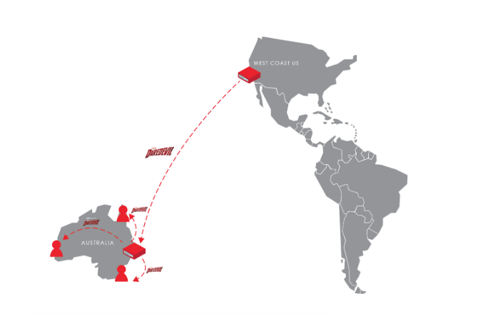
HOW OPEN CONNECT WORKS IN AUSTRALIA?
1. Undersea cables used to access internet content.
3. It is then replicated to dozens of Open Connect servers within each ISP network.
2. They copy each file once from their US-based transcoding repository to the storage locations within Australia.
Done during off-peak hours.

Slide 16
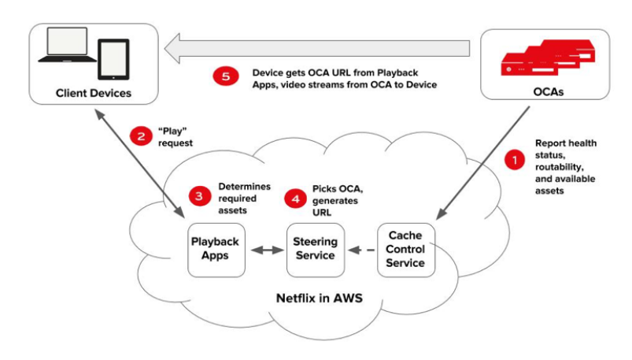
HOW NETFLIX OPEN CONNECT WORKS
The following diagram illustrates how the playback process works:

Slide 17
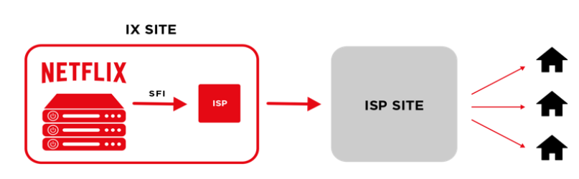
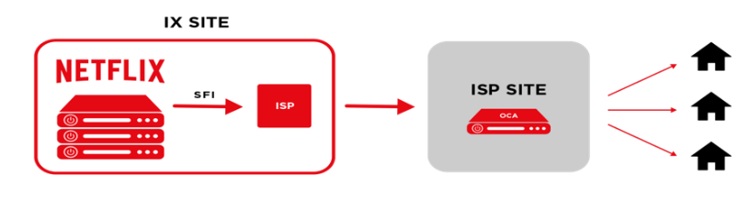
Types of deployments The global network of Netflix OCAs are deployed in two ways:
1. IX deployment
2. Embedded deployment
Netflix installs OCAs within IXPs in significant Netflix markets throughout the world. These OCAs are interconnected with mutually present ISPs via settlement free public or private peering.
Netflix provides OCAs free of charge to qualifying ISPs. These OCAs are deployed directly inside ISP networks. ISPs are provided power, space, and connectivity. ISPs directly control which of their customers are routed to their embedded OCAs.

Slide 18
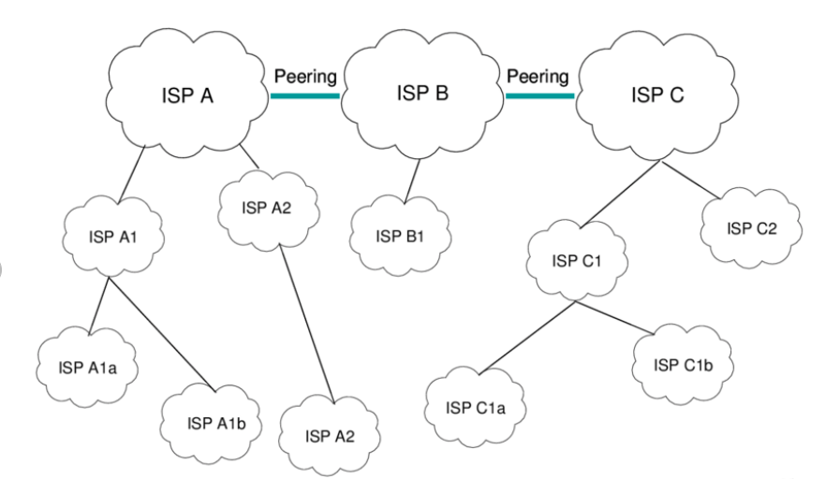
PEERING
Peering is a connectivity method where two networks establish a direct IP connection between their networks, bypassing any third-party networks or middlemen.
The most popular form of peering is known as “settlement-free peering”, where two networks agree to exchange traffic with one another directly without any form of compensation.
Another form is “settlement-based peering” or “paid peering”, where two networks agree to exchange traffic directly, and compensation is involved.
The Netflix Open Connect Program is a settlement-free arrangement of sorts.
If you deploy embedded OCAs, you also set up SFI peering for additional resiliency and to enable nightly content fills and updates.

Slide 19

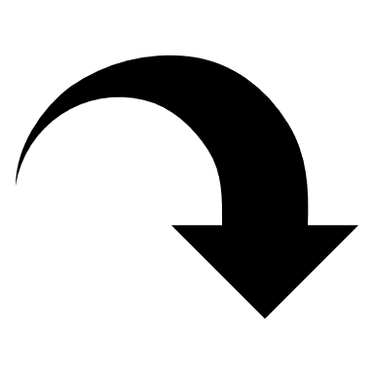
Traffic delivery from an OCA
OCAs are directed-cache appliances.
Serves clients at IP addresses that are advertised to the OCA via a BGP session => ISP partner has full control over the networks that the appliances will serve.
The client request is directed to the closest Netflix content site via peering or transit , if content is not contained on OCA.
Netflix steers clients to our OCAs based on an ISP’s BGP advertisements, coupled with the routing and steering algorithms in the Open Connect control plane.
The control plane steers requests from end-user clients to the best available appliance.

Slide 20
NETFLIX ARCHITECTURE MICROSERVICES
hgk

Slide 21
MONOLITHIC ARCHITECTURE :
Monolithic Code Base: Everyone contributes to one code base that gets deployed on a weekly or a bi-weekly basis.
Monolithic Database: One piece of hardware, difficult to scale vertically.

Slide 22
MICROSERVICES: Evolutionary Response
Single application as a suite of small services, each running in its process and communicating with lightweight mechanism.

Slide 23
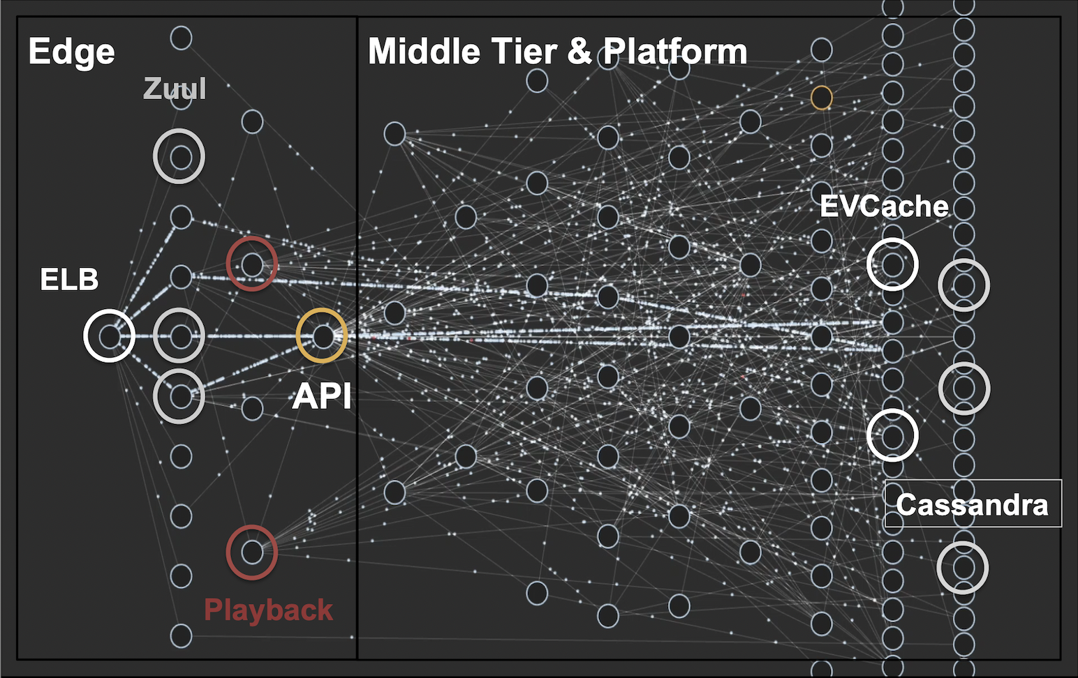
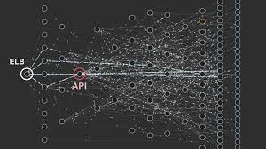

Slide 24
Separation of Concerns
Modularity and Encapsulation
Scalability
Horizontal Scaling
Workload Partitioning
Virtualization and Elasticity
Automated Operations
On Demand Provisioning

Slide 25
CHALLENGES AND SOLUTIONS:
DEPENDENCY
SCALE

Slide 26

DEPENDENCY
Challenge
Improper defence may lead to cascading failure.
Solution
To deal with this Netflix created Hystrix.
Fault Injection Testing

Slide 27

SCALE
Challenge
Stateless Service: instance or node dies you should be able to easily retry it and hit a different instance and proceed on with execution.
Solution
Chaos Testing: Chaos Monkey
Auto Scaling

Slide 28
Due to their decision to embrace microservices-based architecture powered by public cloud from AWS, Netflix was able to ensure zero point of failure and an extremely scalable IT infrastructure to support millions of service requests, without any hiccup.

Slide 29
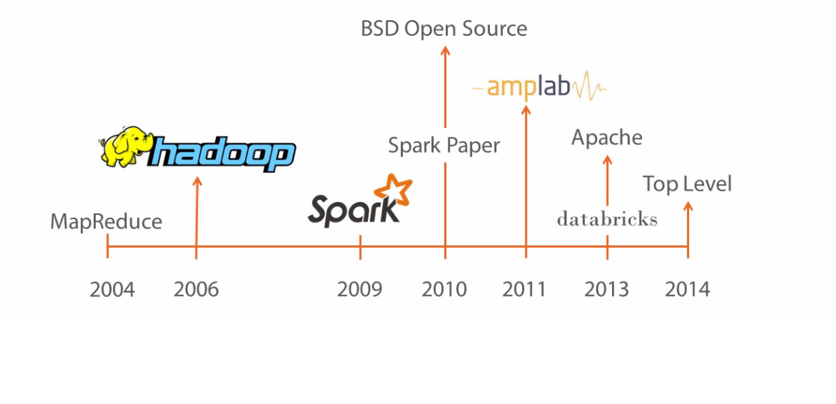

Slide 30


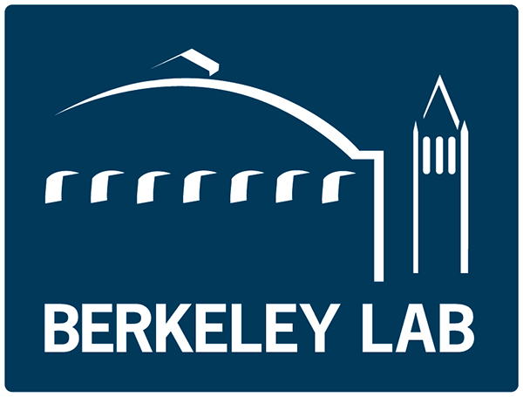

2013
2009
2010
2014

Slide 31
Apache Spark is a lightning-fast unified analytics engine for big data and machine learning.
Goals :
Provide a fast general purpose cluster framework for large scale data processing
Overcome limitations of MapReduce

Slide 32
Processing engine; instead of just “map” and “reduce”, defines a large set of operations (transformations & actions)
Open source software
Supports Java, Scala and Python
Original key construct: Resilient Distributed Dataset (RDD)

Slide 33
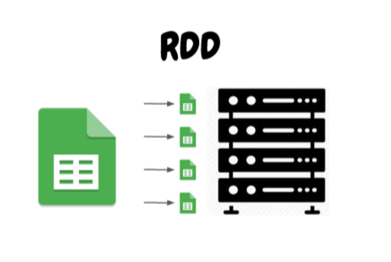
Resilient Distributed Dataset
Foundation of Spark
Represent data or transformations on data
Hide complexity from users

Slide 34

Spark Job
Processing of an RDD
Makes up the core engine for Spark

Slide 35
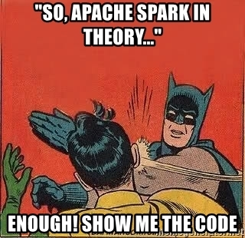

Slide 36
Spark example (Python)
# Estimate π (compute-intensive task).
# Pick random points in the unit square ((0, 0) to (1,1)),
# See how many fall in the unit circle. The fraction should be π / 4
# Note that “parallelize” method creates an RDD
def sample(p):
x, y = random(), random()
return 1 if x*x + y*y < 1 else 0
count = spark.parallelize(xrange(0, NUM_SAMPLES)).map(sample) \
.reduce(lambda a, b: a + b)
print "Pi is roughly %f" % (4.0 * count / NUM_SAMPLES)

Slide 37
Advantages
Fast processing and Speed
Flexible Programmability
Real Time Data processing
Advanced Analytics
- SQL, ML functions
- Graph Processing
Disadvantages
Extreme amount of RAM required

Slide 38


Risk-Based Security
Decision Making at Netflix

Slide 39
Risk Quantification
Uncertainities
Known
Unknown
Unknowable
Guaranteed events
Carry risks (timely eliminatable)
Can be easily simulated
Uncertainty + risk
Hard to be eliminated
All types of uncertainties are considered in Risk analysis
Goal : Reduce the level of uncertainty

Slide 40
Risk Quantification
Quantitative models are used rather than qualitative
Cannot compare Project cost v/s Risk exposure reduction using colours
Hard to make decisions using colours
Netflix shifted from qualitative to quantitative
Risk is the probable frequency and probable magnitude of future events
Risks are divided in 3 tiers based on their depth

Slide 41
Modelling risk at scale
Quantitative models are used rather than qualitative
Cannot compare Project cost v/s Risk exposure reduction using colours
Hard to make decisions using colours
Netflix shifted from qualitative to quantitative
Risk is the probable frequency and probable magnitude of future events
Risks are divided in 3 tiers based on their depth
Annualised loss= Frequency * Magnitude Distribution Mean

Slide 42
Decision making
How decisions are made after risk analysis ?
Risk of an external actor impacting the confidentiality of sensitive data via an application attack
Reduction in loss > Investment in detection control ?
Impact of better detection control in loss reduction

Slide 43
References
https://www.youtube.com/watch?v=ymtq8yjmD9I&ab_channel=nullQueries
https://www.youtube.com/watch?v=wgQkqPmDIAQ
https://about.netflix.com/en/news/how-netflix-works-with-isps-around-the-globe-to-deliver-a-great-viewing-experience
https://openconnect.netflix.com/en/
https://www.youtube.com/watch?v=CZ3wIuvmHeM
https://aws.amazon.com/microservices/
https://readwrite.com/how-netflix-adopted-nosql/
https://aws.amazon.com/solutions/case-studies/netflix/
https://www.fool.com/investing/2022/01/23/netflix-stock-crashes-22-is-it-a-good-value-stock/

Slide 44
Thank You

